Slide 1
Chapter 2
Software process model

Slide 2
overview
Definition of process and its characteristics
Example of software process model
The models characteristics

Slide 3
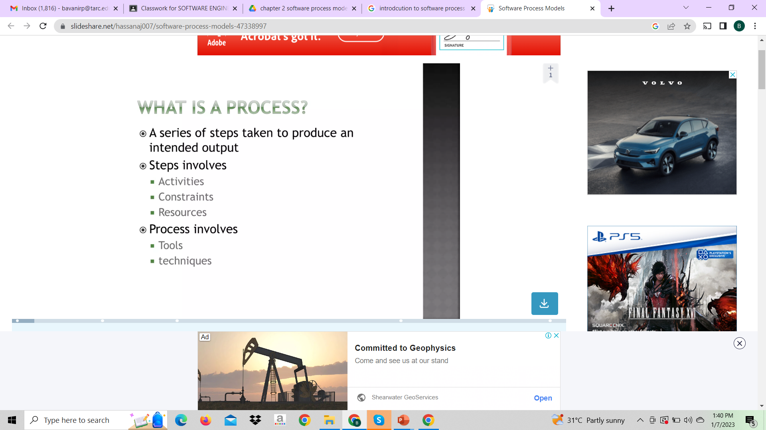

Slide 4
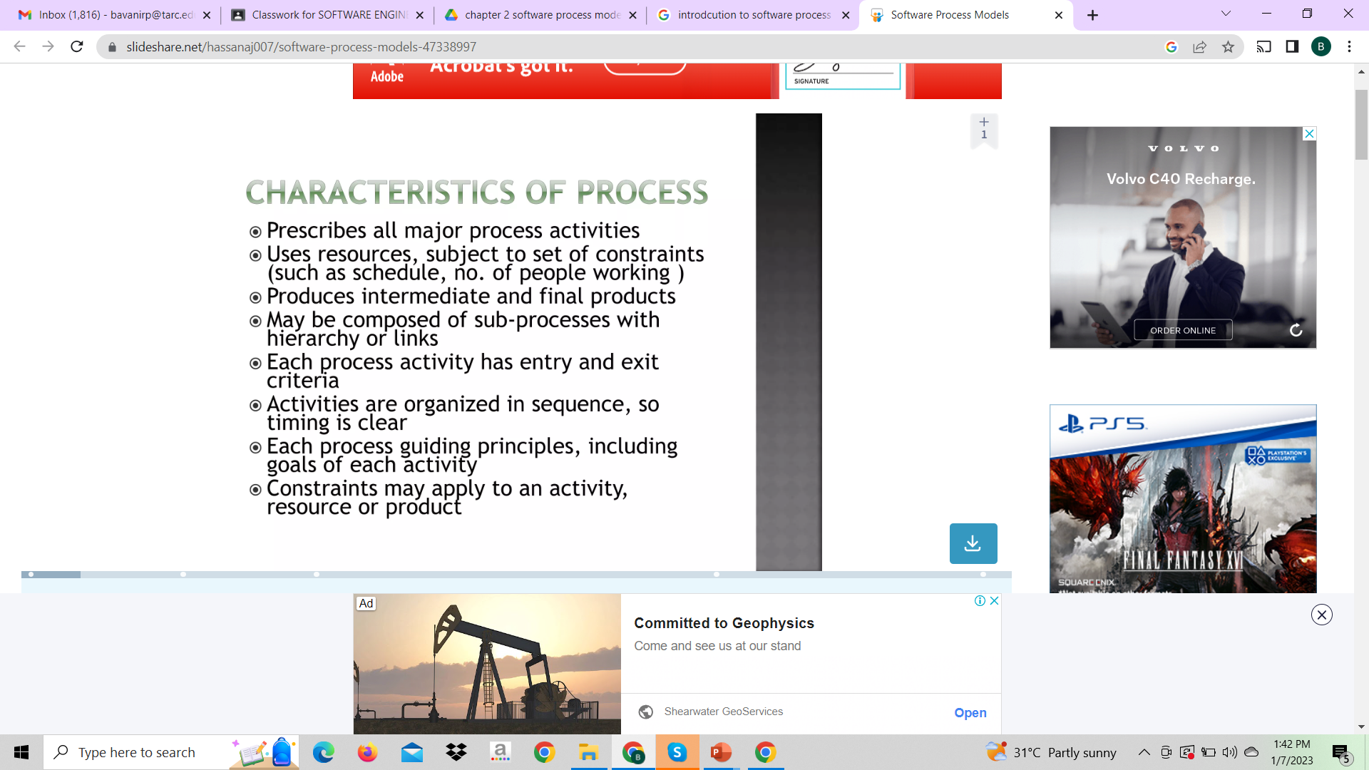

Slide 5
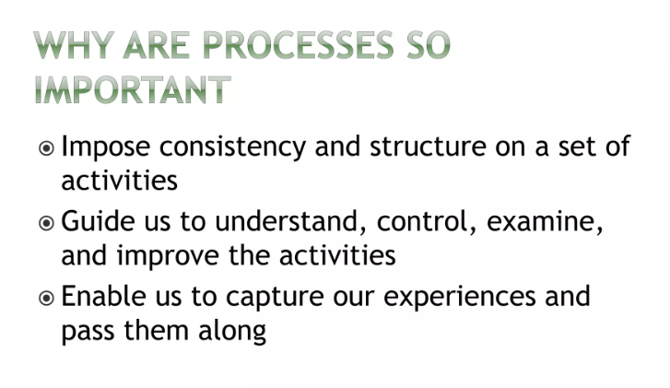

Slide 6
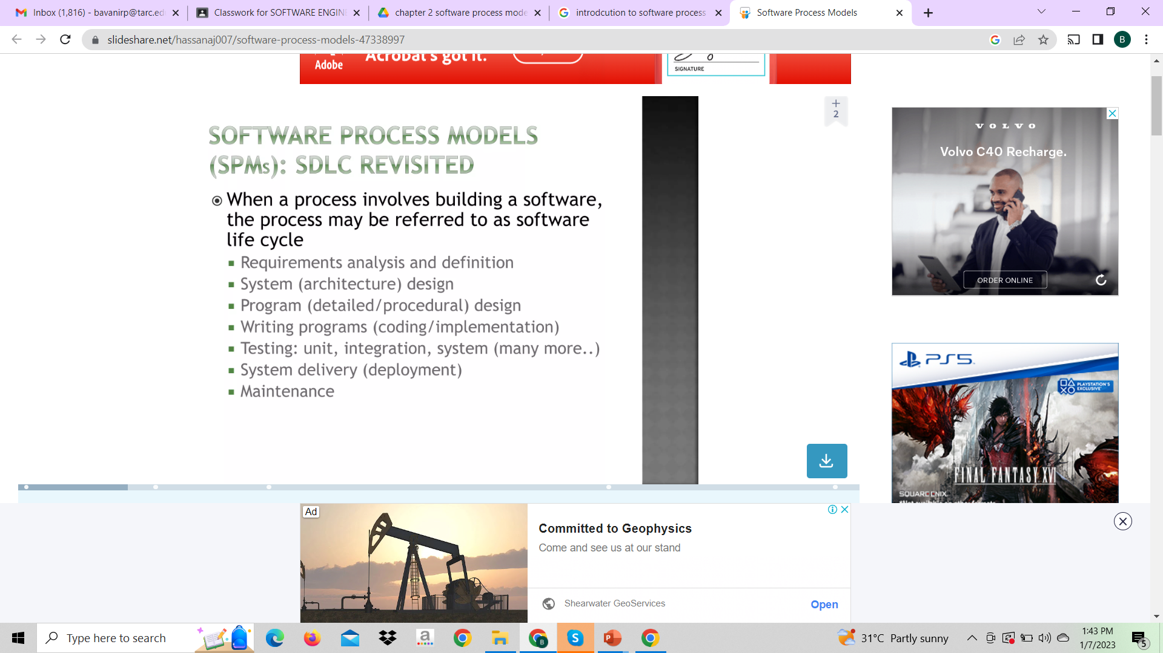

Slide 7
Software Process
Activities to develop software
Software Specification
Software Development
Software Evolution
Software Validation
Basic Activities
Software Product

Slide 8
Software Process
Software process consists of activities, which are involved in developing software products.
Basic activities are:-
Software Specification
Software Development
Software Validation
Software Evolution

Slide 9

Software Process Model
Including:
SW processes
Roles
Products
Simplified description of software processes
Different perspectives

Slide 10
Software Process Model
Software process model is a simplified description of a software process which is presented from a particular perspective.
May include activities which are part of the software process, software products and the roles of people involved in software engineering

Slide 11
Software Process Model
Linear Sequential Model/Waterfall Model
Incremental model
Spiral model
Prototyping Model
Rapid Application Model
Component-based Development Model
Agile Software Development
Xp Model
FDD Model

Slide 12
Introduction
SDLC or the Software Development Life Cycle is a process that produces software with the highest quality and lowest cost in the shortest time possible.
SDLC provides a well-structured flow of phases that help an organization to quickly produce high-quality software which is well-tested and ready for production use

Slide 13
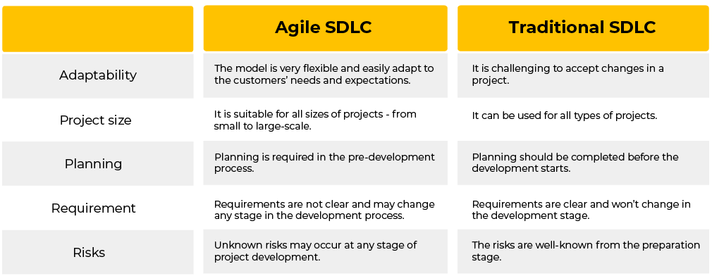

Slide 14
Traditional SDLC

Slide 15
Waterfall model

Slide 16
Waterfall model
Requirements. Potential requirements, deadlines and guidelines for the project are analyzed and placed into a formal requirements document, also called a functional specification. This stage of development defines and plans the project without mentioning specific processes.
Analysis. The system specifications are analyzed to generate product models and business logic to guide production. This is also when financial and technical resources are audited for feasibility.
Design. A design specification document is created to outline technical design requirements, such as the programming language, hardware, data sources, architecture and services.
Coding and implementation. The source code is developed using the models, logic and requirement specifications designated in the prior phases. Typically, the system is coded in smaller components, or units, before being put together.
Testing. This is when quality assurance, unit, system and beta tests identify issues that must be resolved. This may cause a forced repeat of the coding stage for debugging. If the system passes integration and testing, the waterfall continues forward.
Operation and deployment. The product or application is deemed fully functional and is deployed to a live environment.
Maintenance. Corrective, adaptive and perfective maintenance is carried out indefinitely to improve, update and enhance the product and its functionality. This could include releasing patch updates and new versions.

Slide 17
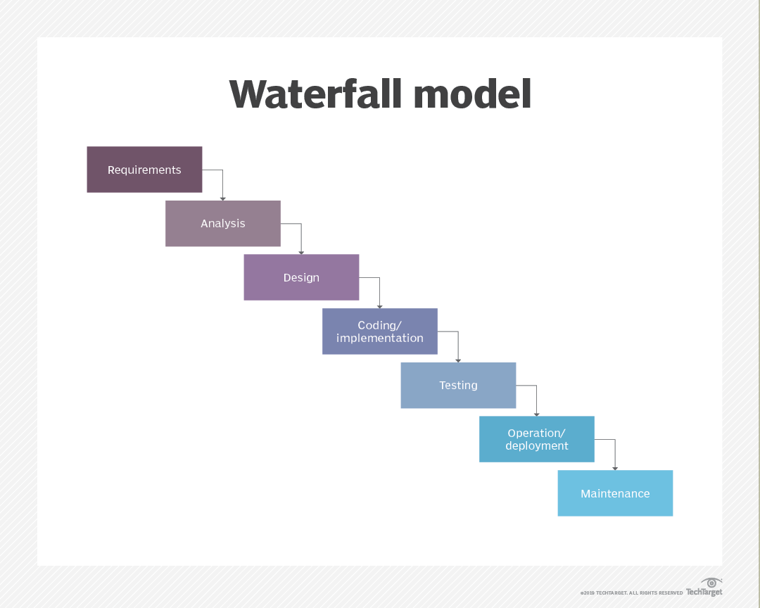

Slide 18
When can we used waterfall model
fixed requirements
ample resources
an established timeline
well-understood technology
unlikely to require significant changes.

Slide 19
Advantages of waterfall model
enables large or changing teams to move toward a common goal that's been defined in the requirements stage;
forces structured, disciplined organization;
simplifies understanding, following and arranging tasks;
enables early system design and specification changes to be easily done
clearly defines milestones and deadlines.

Slide 20
Disadvantages of the waterfall model
Design isn't adaptive; when a flaw is found, the entire process often needs to start over.
Waterfall model delays testing until the end of the development lifecycle.
Waterfall isn't ideal for complex, high-risk ongoing projects.
No working product is available until the later stages of the project lifecycle.

Slide 21
Incremental model
This model requirements are broken down into multiple standalone modules of software development cycle.
In incremental model the whole requirement is divided into various builds.
In Incremental Model, each module passes through the requirements, design, implementation and testing phases

Slide 22
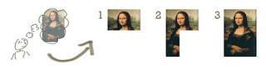
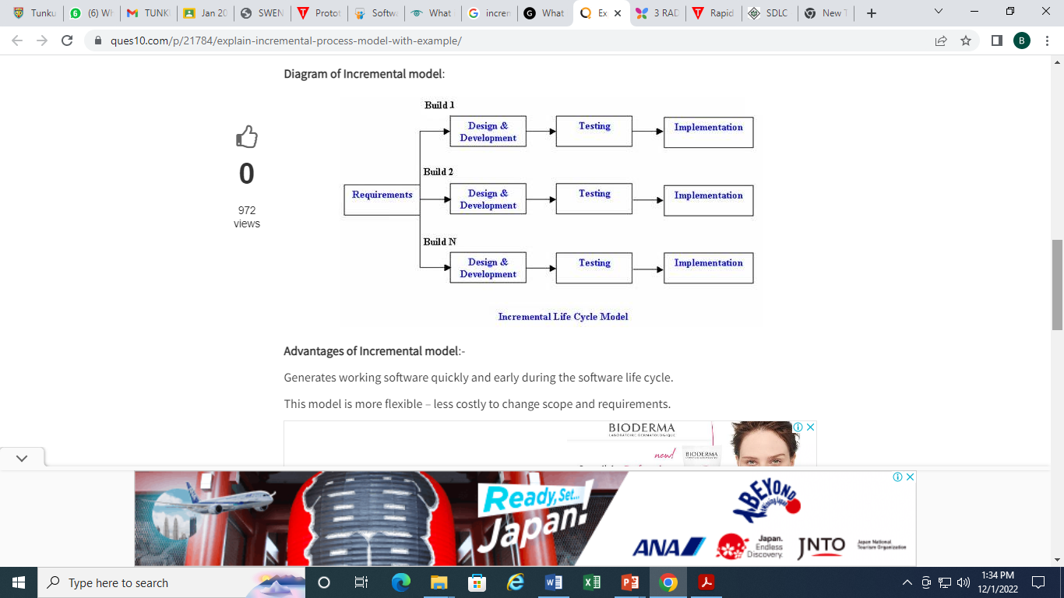

Slide 23
Advantages of Incremental model:
Generates working software quickly and early during the software life cycle.
This model is more flexible – less costly to change scope and requirements.
It is easier to test and debug during a smaller iteration.
In this model customer can respond to each built.
Lowers initial delivery cost.
Easier to manage risk because risky pieces are identified and handled during it’d iteration.

Slide 24
Disadvantages of Incremental model:
Needs good planning and design.
Needs a clear and complete definition of the whole system before it can be broken down and built incrementally.

Slide 25
When to use the Incremental model:
This model can be used when the requirements of the complete system are clearly defined and understood.
Major requirements must be defined; however, some details can evolve with time.
There is a need to get a product to the market early.
A new technology is being used
Resources with needed skill set are not available
There are some high risk features and goals.

Slide 26
spiral model
The spiral model is also known as the cyclic model.
Using the spiral model, the software is developed in a series of incremental releases.
During later iterations, more and more complete versions of the engineered system are produced.
The spiral model has four phases: Planning, Design, Construct and Evaluation

Slide 27
When to use Spiral Model?
When deliverance is required to be frequent.
When the project is large
When requirements are unclear and complex
When changes may require at any time
Large and high budget projects

Slide 28
Advantages
High amount of risk analysis
Useful for large and mission-critical projects.

Slide 29
Disadvantages
Can be a costly model to use.
Risk analysis needed highly particular expertise
Doesn't work well for smaller projects.

Slide 30
Prototyping model
The prototype model requires that before carrying out the development of actual software, a working prototype of the system should be built.
A prototype is a toy implementation of the system.
This model works best in scenarios where not all of the project requirements are known in detail ahead of time.
It is an iterative, trial-and-error process that takes place between the developers and the users.

Slide 31
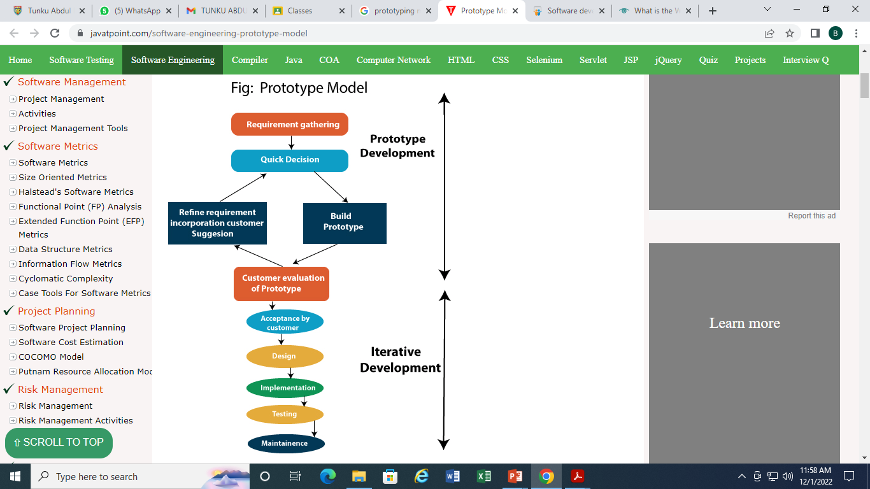
Steps of Prototype Model:
Requirement Gathering and Analyst
Quick Decision
Build a Prototype
Assessment or User Evaluation
Prototype Refinement
Engineer Product

Slide 32
Advantage of Prototype Model
The customers get to see the partial product early in the life cycle. This ensures a greater level of customer satisfaction and comfort.
• New requirements can be easily accommodated as there is scope for refinement.
• Missing functionalities can be easily figured out.
• Errors can be detected much earlier thereby saving a lot of effort and cost, besides enhancing the quality of the software.
• The developed prototype can be reused by the developer for more complicated projects in the future.
• Flexibility in design.

Slide 33
Disadvantages –
• There may be too much variation in requirements each time the prototype is evaluated by the customer.
• Poor Documentation due to continuously changing customer requirements.
• It is very difficult for the developers to accommodate all the changes demanded by the customer.
• There is uncertainty in determining the number of iterations that would be required before the prototype is finally accepted by the customer.
• After seeing an early prototype, the customers sometimes demand the actual product to be delivered soon.
• Developers in a hurry to build prototypes may end up with sub-optimal solutions.
• The customer might lose interest in the product if he/she is not satisfied with the initial prototype.

Slide 34
When to use porotype model
This model is used when the customers do not know the exact project requirements beforehand.
When the developers are new to the domain.
In this model, a prototype of the end product is first developed, tested and refined as per customer feedback repeatedly till a final acceptable prototype is achieved which forms the basis for developing the final product.

Slide 35
Types of Prototyping Models
Four types of Prototyping models are:
Rapid Throwaway prototypes
Evolutionary prototype
Incremental prototype
Extreme prototype

Slide 36
Types of model
Rapid Throwaway Prototype
Rapid throwaway is based on the preliminary requirement. It is quickly developed to show how the requirement will look visually. The customer’s feedback helps drives changes to the requirement, and the prototype is again created until the requirement is baselined.
In this method, a developed prototype will be discarded and will not be a part of the ultimately accepted prototype. This technique is useful for exploring ideas and getting instant feedback for customer requirements.
Evolutionary Prototyping
Here, the prototype developed is incrementally refined based on customer’s feedback until it is finally accepted. It helps you to save time as well as effort. That’s because developing a prototype from scratch for every interaction of the process can sometimes be very frustrating.
This model is helpful for a project which uses a new technology that is not well understood. It is also used for a complex project where every functionality must be checked once. It is helpful when the requirement is not stable or not understood clearly at the initial stage.

Slide 37
Incremental Prototyping
In incremental Prototyping, the final product is decimated into different small prototypes and developed individually. Eventually, the different prototypes are merged into a single product. This method is helpful to reduce the feedback time between the user and the application development team.
Extreme Prototyping:
Extreme prototyping method is mostly used for web development. It is consists of three sequential phases.
Basic prototype with all the existing page is present in the HTML format.
You can simulate data process using a prototype services layer.
The services are implemented and integrated into the final prototype.

Slide 38
RAD MODEL
The RAD (Rapid Application Development) model is based on prototyping and iterative development with no specific planning involved.
The process of writing the software itself involves the planning required for developing the product.

Slide 39
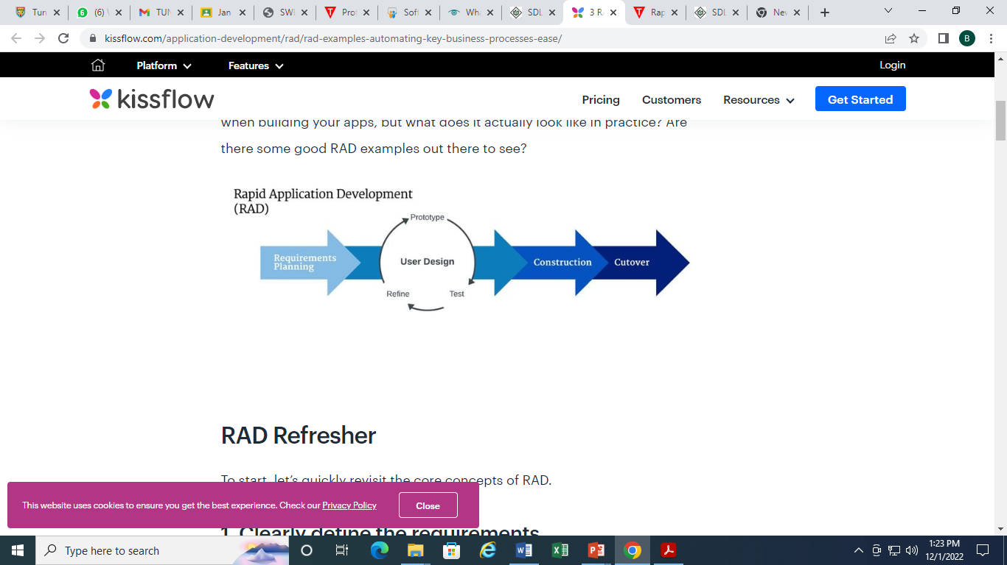

Slide 40
Advantage of RAD Model
This model is flexible for change.
In this model, changes are adoptable.
Each phase in RAD brings highest priority functionality to the customer.
It reduced development time.
It increases the reusability of features.

Slide 41
Disadvantage of RAD Model
It required highly skilled designers.
All application is not compatible with RAD.
For smaller projects, we cannot use the RAD model.
On the high technical risk, it's not suitable.
Required user involvement.

Slide 42
When to use RAD Model?
When the system should need to create the project that modularizes in a short span time (2-3 months).
When the requirements are well-known.
When the technical risk is limited.
When there's a necessity to make a system, which modularized in 2-3 months of period.
It should be used only if the budget allows the use of automatic code generating tools.

Slide 43
Component-based Development Model
Component Based Development (CBD) relies on creating “components” - a defined set of design elements and functionalities - and then putting them together to develop a complete page or site or application.

Slide 44
Component-based Development Model
Define the components: What each component looks like and how it functions. So elements like a button, a social share widget, a video, a text box are all components that are designed and developed to function in a particular manner.
Design the interactions: Define how components interact with each other. This ensures that there is a predictable outcome, every time we put certain components together.
Develop the system: Once components and their interactions are in place, development becomes just a matter of putting components together to create the systems we want.

Slide 45
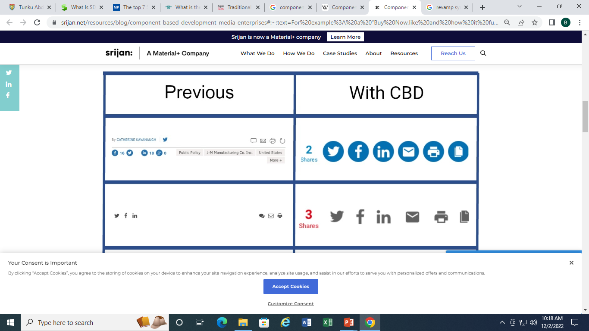
This is just a small example of how we reused components across different sites.

Slide 46
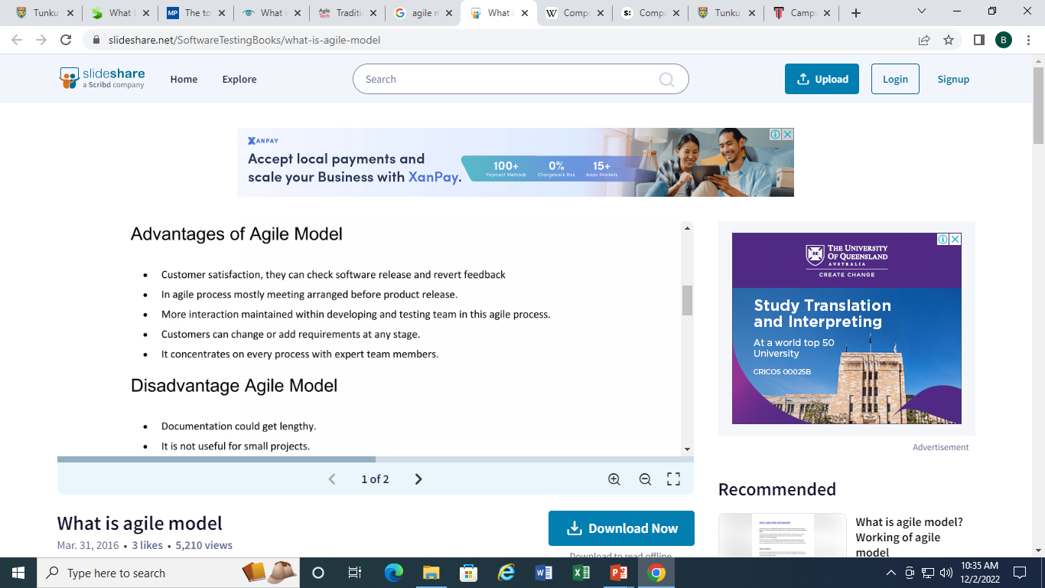
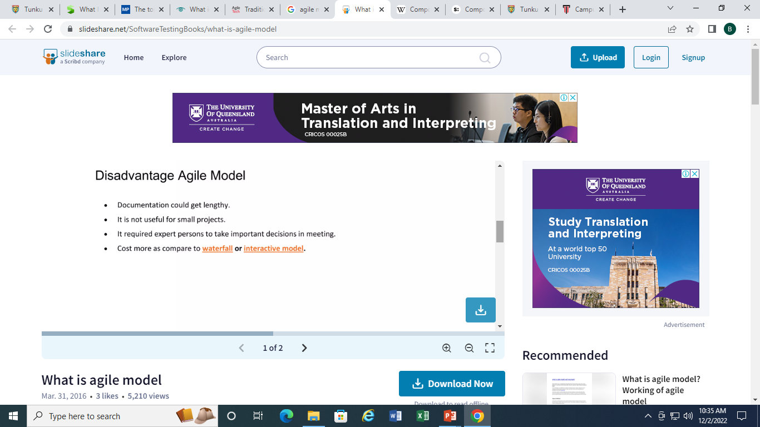
Agile methodology
Agile is an approach to software development that seeks the continuous delivery of working software created in rapid iterations.

Slide 47
Extreme Programming (XP)
XP is the most specific Agile framework for software development practices. It aims to not only produce high-quality software but to make the entire process easier on the development team itself.
XP values communication, feedback, simplicity, courage, and respect.

Slide 48
It’s best applied when
There are constantly changing requirements
Teams have tight deadlines
Stakeholders want to reduce risk under deadlines
Teams can automate unit and functional tests

Slide 49
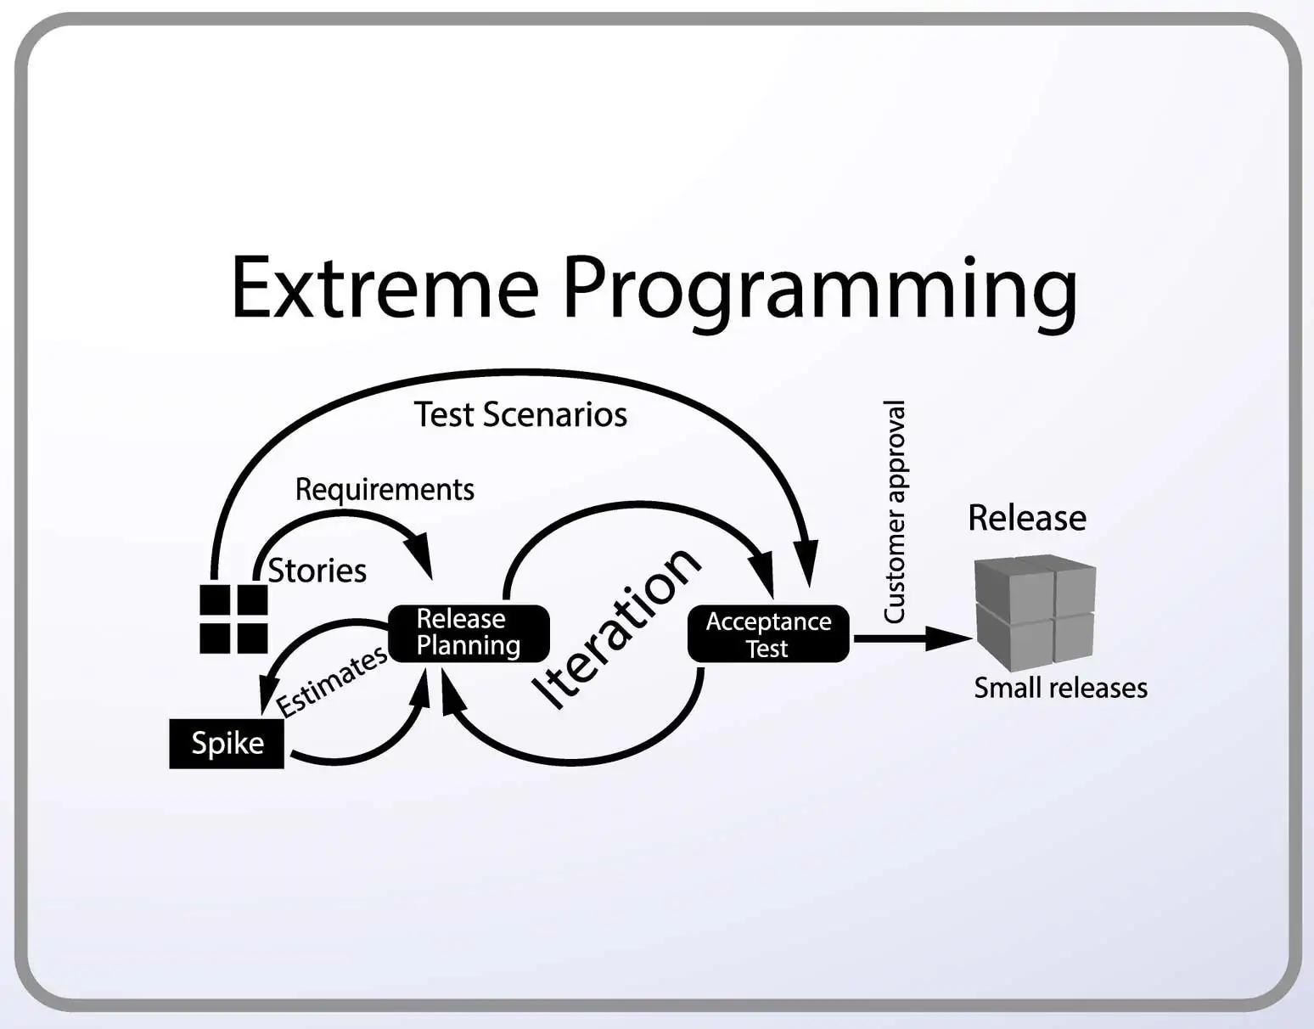

Slide 50
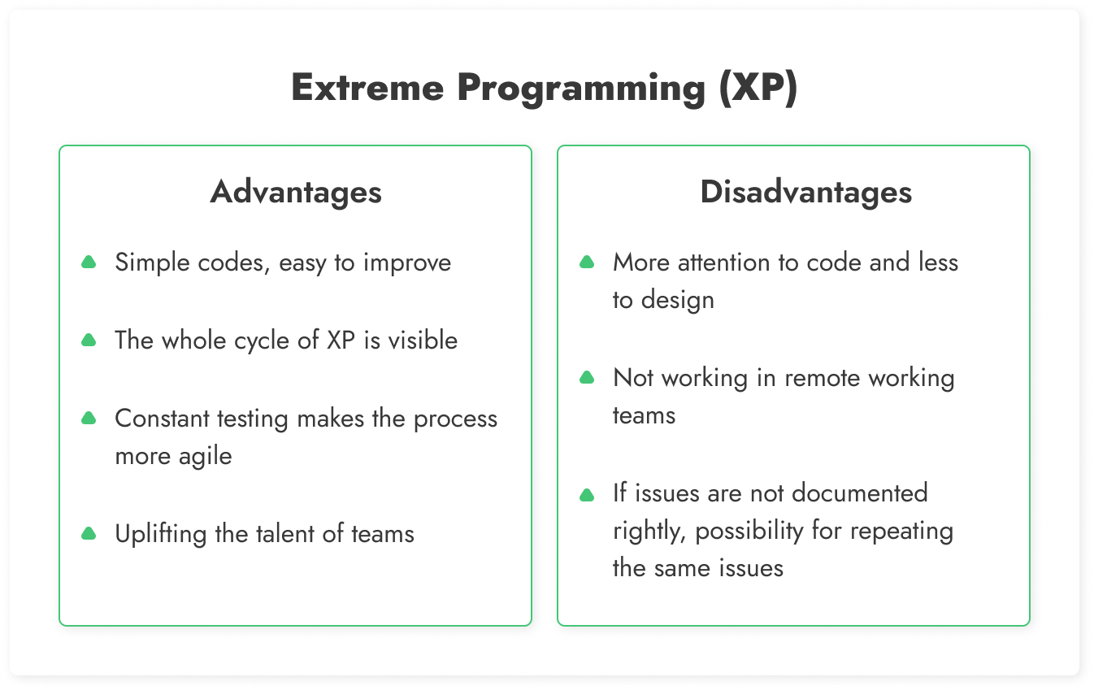

Slide 51
Feature Driven Development
Feature Driven Development (FDD) is a client-centric Agile methodology tool that focuses on incremental development and status reporting across all levels.
FDD is a scalable model that delivers features on a much shorter timeframe than other Agile frameworks. For instance, instead of a typical 4-week iteration cycle in Scrum, FDD aims to deliver features every 2-10 days. This makes it easier for teams to track and address errors, adapt to client requests, and get new team members up-to-date quickly.

Slide 52
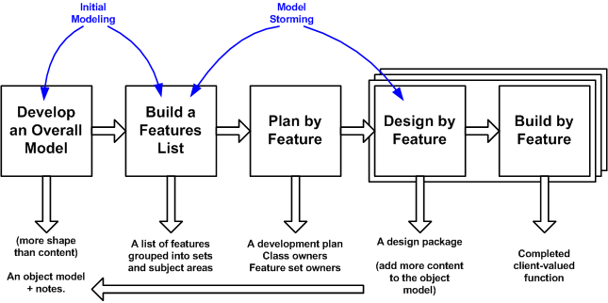

Slide 53
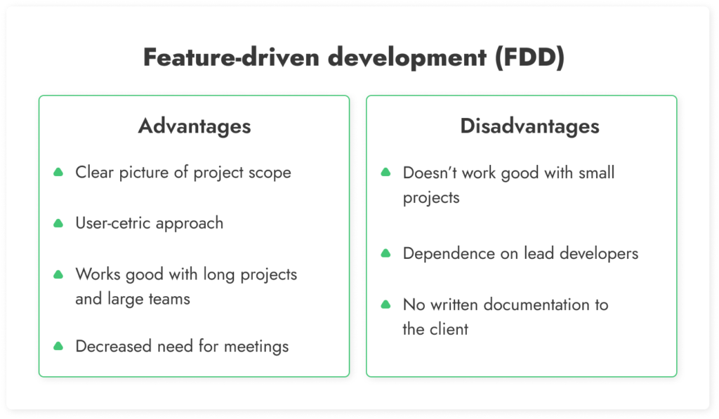

Slide 54
Exercise
The software organization you are working with has recently successfully bid for a project to develop an e-learning system for a local established college. You are being assigned as a project manager to lead a project team of 12 members to handle this project.
During the requirement analysis stage, you found out that some of the requirements have not confirmed and finalized by your client. Furthermore, some of the hardware needed to develop certain parts of the system have to order from oversea vendors and they cannot promise the availability of these hardware in the early stage of development. However, your client wants the confirmed areas of the system to be delivered within two months time so that they can use this new system as part of the marketing strategies for the coming new academic intake.
Recommend an appropriate process model you would use to manage the above project. Justify your selection. You may state any assumptions to support your answer.

Slide 55
Thank you

